Slide 1
Laboratory of extreme reproductive strategies in extreme environments a.k.a
Cobitis group

Slide 2
Research aims
Multidisciplinary research, intensive usage of natural models as suited alternative to “classical” model organisms
Evolution and consequences of non-Mendelian reproductive modes
  Why sex prevails in nature
  What triggers the emergence of asexual reproduction
  Molecular pathways underlying the production of unreduced gametes
Life in a freezer: adaptation to polar environment and life on glacier
  How glacier organisms evolved
  What is the connectivity among animal populations on ice sheets and glaciers on local and global scales
  What physiological adaptations do glacier organisms have to cope with extreme environmnent

Slide 3
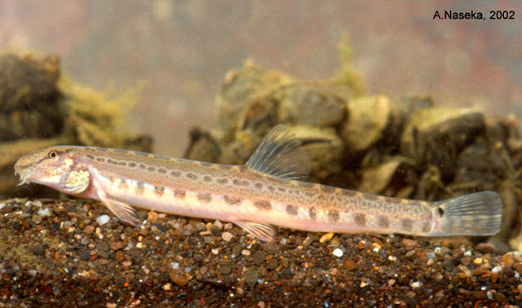
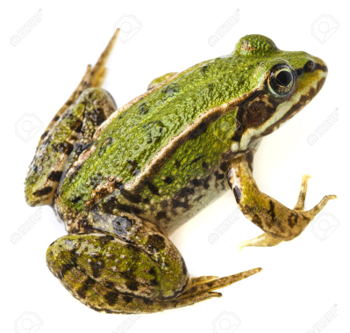
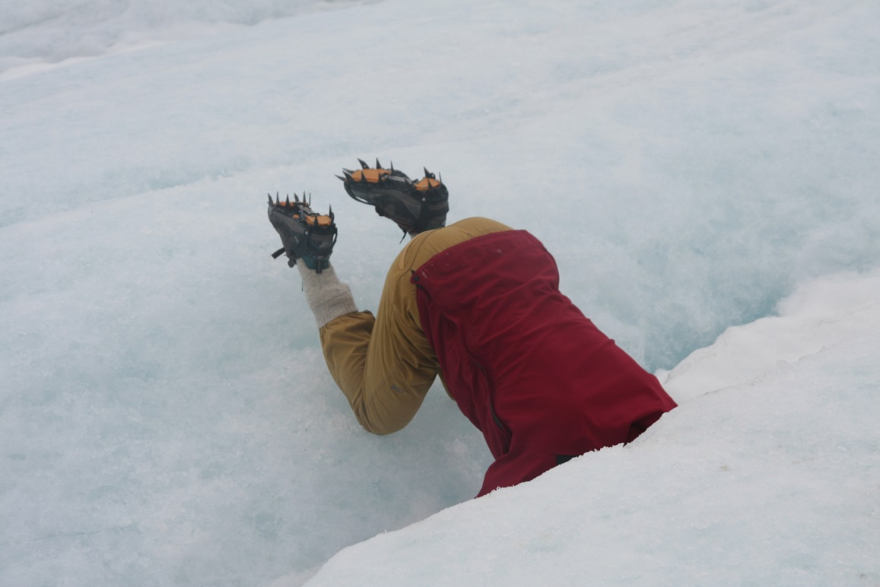
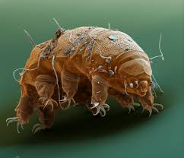
Models
Cobitis spined loaches – fish model for link between speciation with gene flow, formation of postzygotic reproductive incompatibilities and emergence of asexual gametogenesis
Pelophylax waterfrogs – model for mechanisms of genome elimination
Tardigarada & Bdelloidea – animal models for adaptation to glacial environment and colonisation of extreme habitats

Slide 4
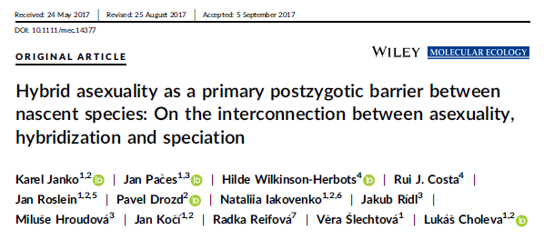
Key results
Inherent link between speciation and asexual reproduction: Speciation continuum involves an inherent stage when interspecific hybrids maintain fertility, but produce unreduced gametes. Such a stage simultaneously promotes the accomplishment of speciation as well as the formation of clones.

Slide 5
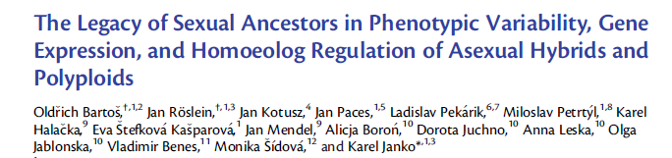
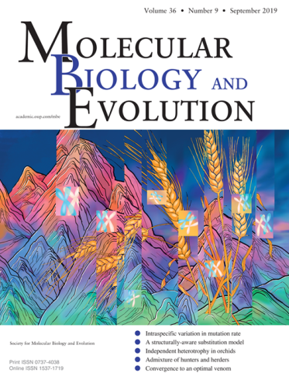
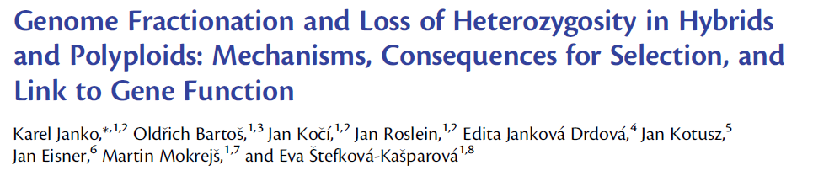
Key results
Genetic control of hybrid and polyploid phenotypes is much more complex than previously believed:
  Intermediate phenotypes are not caused by additive expression of genes but instead by a combination of many genes, which maintain the expression level of one or the other parent, altogether leading to apparent intermediacy.
  Polyploidy exerts major impact on phenotypes by altering trans-regulation between hybrid’s subgenomes: while cis-regulation is more pervasive in diploids, triploids have significantly more efficient trans-regulation.

Slide 6
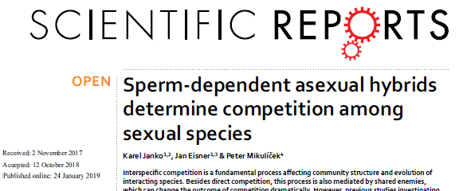
Key results
Asexual organisms, despite their rarity, have major impact on ecosystems’ diversity

Slide 7
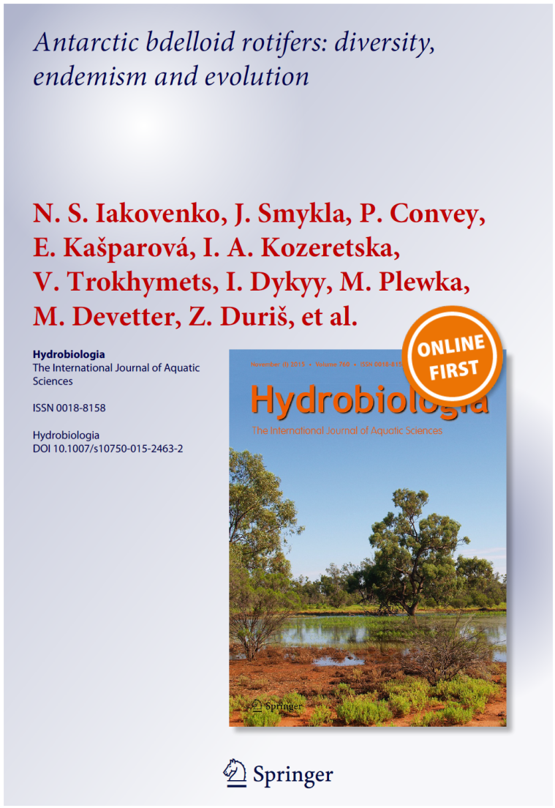
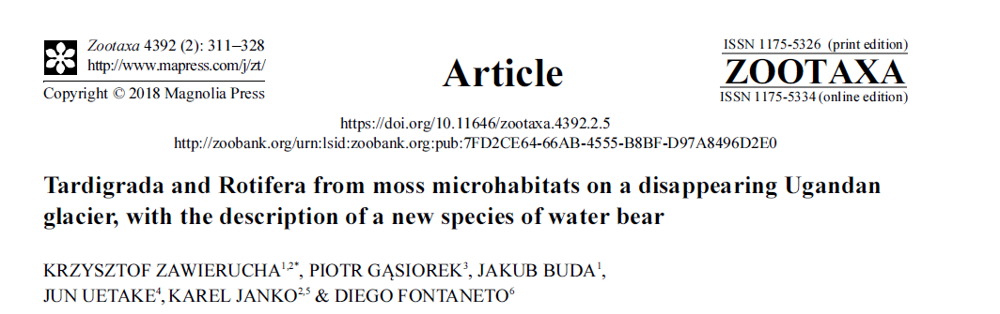
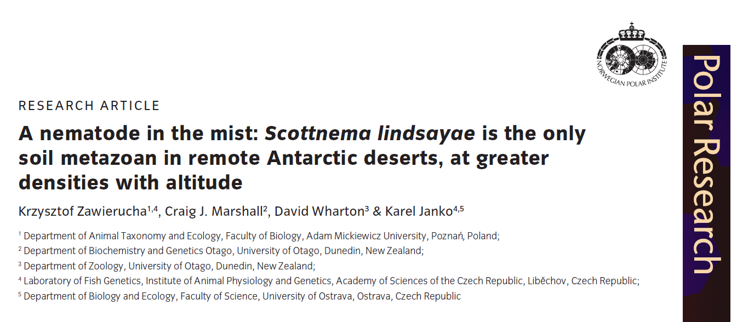
Key results
Diversity of polar rotifers is not lower than lower latitudes; instead, polar ecosystems host unexpected amount of endemic species
Glaciers are inhabitted by distinct community of to-consumers that is not encountered in surrounding habitats
Despite harsh environment, population densities of invertebrates increase with altitude in polar deserts

Slide 8
Ongoing projects/future directions
We expand on the new research direction aiming to understand the aberrations of reproductive modes as inherent stages of “classical” speciation continuum.
We develop the new conceptual look at the link between genotype and phenotype from the perspective of gene dose in diploid and polyploid organisms
We investigate the world-wide evolution of communities of top-consumers in glacial habitats
Ongoing financial support from GAČR (19-21552S, 21-25185S, 22-28778S) and the Ministry of Education, Youth and Sports of the Czech Republic grant EXCELLENCE CZ.02.1.01/0.0/0.0/15_003/0000460 OP RDE)

Slide 9
Societal relevance of our research
We see two major outreach of our research
  the research focus on genome interactions and genotype-phenotype link in asexual and polyploid animals has imminent link to cancer research, developmental defects of aneuploids and reproductive aberrations, including biomedicine research, where some our papers have been cited.
  Our research of polar environments has direct consequences to understanding the threads of ongoing climate change and its mitigation

Slide 10
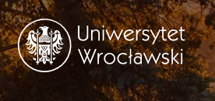

International collaboration
University of Wroclaw
University of Oklahoma
University of Oslo

Slide 11
The team
Team leader: Mgr. Karel Janko, PhD.
Researchers: RNDr. Marie Kaštánková- Doležálková Ph.D., Ing. Karel Halačka CSc.
Postdocs: Dr. Dmitrii Dedukh, Dr. Stephen Schlebush, Mgr. Eva Kašparová-Štefková Ph.D.
Students: Mgr. Anatolie Marta, Mgr. Tomáš Tichopád, Mgr. Daniel Kulik, Ing. Patrik Horna

