Slide 1



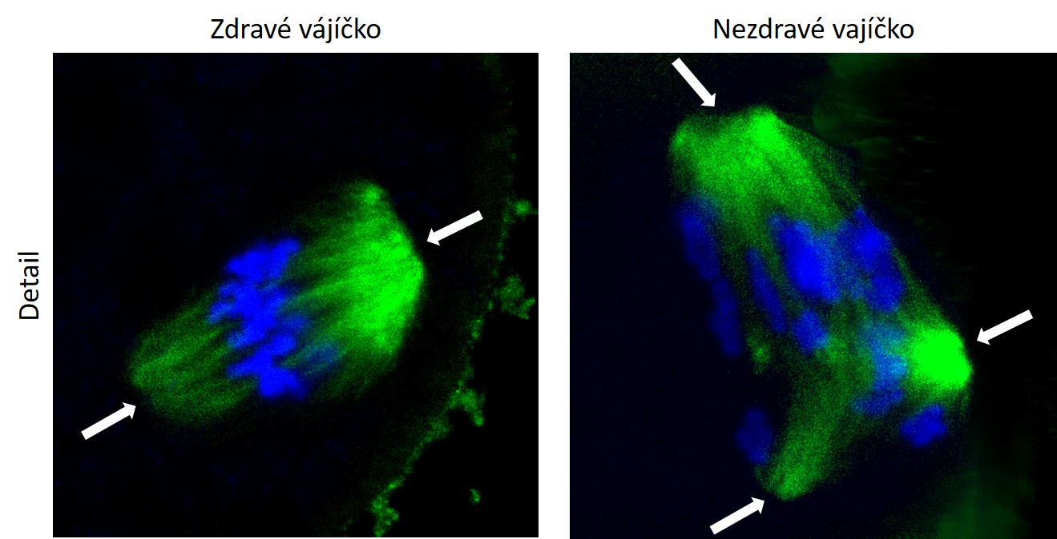
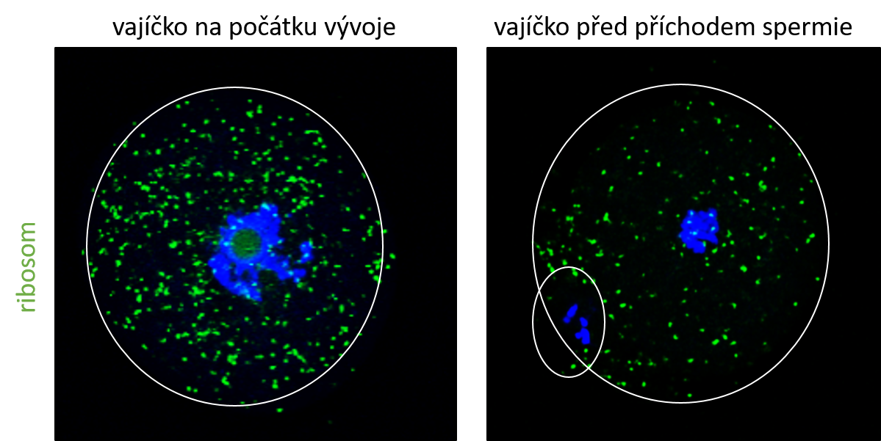
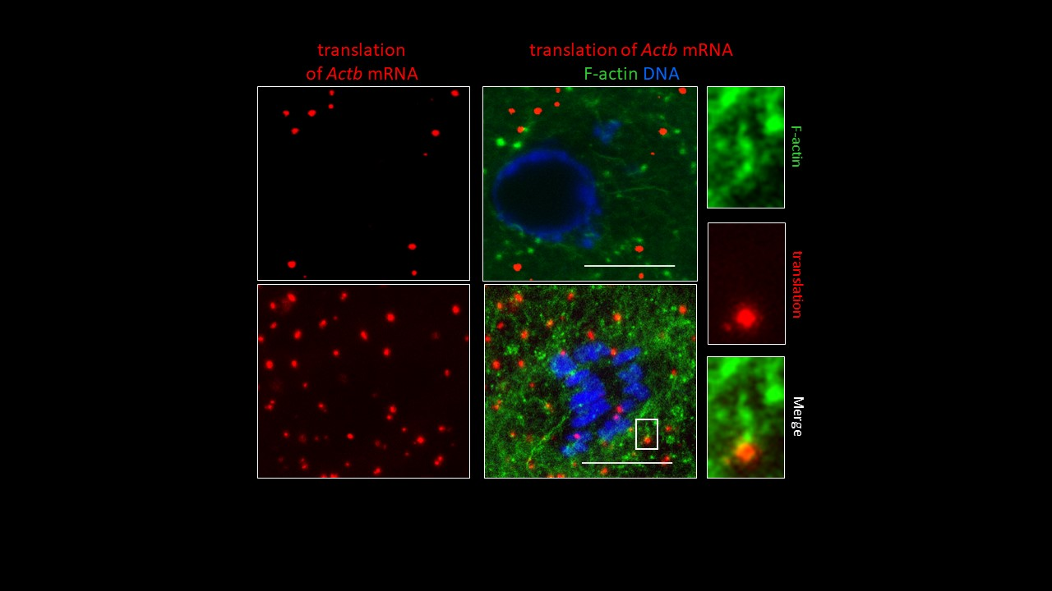
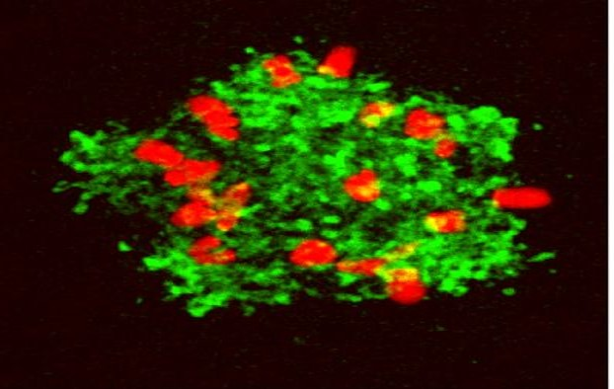
Institute of Animal Physiology and Genetics CAS
PhD Position in Developmental Biology Open
How RNA Controls Early Life
Join our team to uncover how RNA metabolism shapes oocyte maturation and early embryo development.
We study molecular mechanisms controlling oocyte maturation and early embryonic development, with a focus on RNA metabolism and gene expression regulation.
The position is based at the Institute of Animal Physiology and Genetics (Czech Academy of Sciences) and jointly supervised with Charles University in Prague.
WHO WE ARE LOOKING FOR
MSc in biology, molecular biology, biochemistry or related field
Passionate about cell and molecular biology
Curious, motivated and proactive
Able to work independently and in a team
Confortable communicating in English
WHAT YOU WILL GAIN
Hands-on training in advanced molecular and cell biology
International collaborations
State-of-the-art facilities
Supportive research environment
Full-time PhD position/ Start: Oct 2026
Competitive salary + full social security
HOW TO APPLY
Send one pdf (max 3 pages) including:
CV, motivation letter, contact for two referees
Deadline: April 8, susor@iapg.cas.cz
CONTACT
Andrej Šušor
Laboratory of Biochemistry and Molecular Biology of Germ Cells
www.iapg.cas.cz

Slide 2
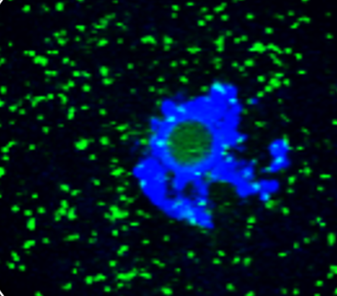

Institute of Animal
Physiology and Genetics CAS
Institute of Animal Physiology and Genetics CAS
PhD Position Open
How RNA Controls Early Life
Join our team to uncover how RNA metabolism shapes oocyte maturation and early embryo development.
Deadline: April 8
Position based at IAPG CAS and Charles University in Prague.
WHO WE ARE LOOKING FOR
MSc in biology, molecular biology, biochemistry or related field
Passionate about cell and molecular biology
Curious, motivated and proactive
Able to work independently and in a team
Confortable communicating in English
WHAT YOU WILL GAIN
Hands-on training in advanced molecular and cell biology
International collaborations
State-of-the-art facilities
Supportive research environment
Full-time PhD position/ Start: Oct 2026
Competitive salary + full social security
HOW TO APPLY
Send one pdf (max 3 pages) including:
CV, motivation letter, contact for two referees
Deadline: April 8, susor@iapg.cas.cz
CONTACT
Andrej Šušor
Laboratory of Biochemistry and Molecular Biology of Germ Cells
www.iapg.cas.cz

